Slide 1
Applying for GISCI Certification: A Step by Step Guide to Completing an Application for GIS Professional Certification Overview

Slide 2
Steps
The Educational Achievement Component (forms EDU 1, 2, 3, S & X)
The Professional Experience Component (forms EXP W, P & S)
The Contributions to the Profession Component (form CON-1)
Total Certification Points (form TOT-1)

Slide 3
Getting Started
Download all necessary documents from the GISCI website at www.gisci.org
An application packet includes:
The Application
A Procedures Manual
The GIS Code of Ethics
An Application Packet containing a welcome letter, payment form, checklist, and questionnaire

Slide 4
Filling out the Application
The application may be completed in two ways: 1. Manual Entry (print out forms and complete in ink) 2. Electronic Entry (complete the forms electronically, print, and combine with documentation)
All applications need to be sent as paper copies. No electronic documents will be accepted

Slide 5
Helpful Tip Before you Begin
There is no benefit to documenting a high point total. The point total is used only during application assessment and is not noted or reflected in your final certificate. It is unnecessary to expend extensive effort documenting minor achievements unless the point values are needed to meet the minimum.

Slide 6
Request External Official Documentation
Primary materials include:
Letter from your immediate supervisor
college transcript(s)
Secondary materials may include:
certificates of completion / participation
awards
publications
course catalogs, class syllabi, class reports/projects

Slide 7
Removal of Personal Information
All sensitive or personal information (i.e. social security number, drivers license number, maiden name, etc.) may be removed or obscured from any document. If this information is included only the GISCI staff and Review Committee Members will view it.

Slide 8
The Certification Process
Requires completion of all three components (EDU, EXP, & CON).
Requires providing proper documentation.

Slide 9

The Educational Achievement Component
See The Educational Experience Component Instructions

Slide 10
The Professional Experience Component
See The Professional Experience Component Instructions

Slide 11
The Contributions to the Profession Component
See The Contributions Component Instructions

Slide 12
The Total Certification Points Component

Slide 13
The Total Certification Points Component
The Applicant will need a minimum of 150.0 Points to become certified.

Slide 14
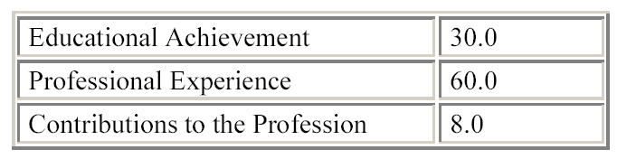
The Total Certification Points Component
The applicant will need the following minimums in the three achievement categories:
The candidates will also need an additional 52 points in any of the three categories.

Slide 15
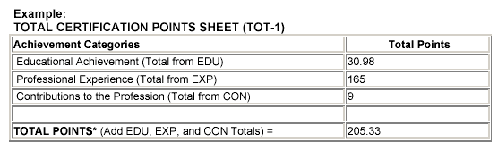
Completing the Total Certification Point Sheet (Form TOT-1)
After all three components have been completed, the totals from each form (EDU, EXP, and CON) should be added to the Total Certification Points sheet (TOT-1)

Slide 16
Completing the Total Certification Point Sheet (Form TOT-1)
This number must meet or exceed 150 points in order to be considered eligible for GISCI certification.

Slide 17
You have now completed the body of the Application.
But you aren’t done yet!

Slide 18
Full Payment and Payment Form
A GISCI application will not be processed unless full payment accompanies the portfolio.
GISCI accepts checks and credit cards.

Slide 19
The Code of Ethics Acknowledgment Form
Included with the application packet is a copy of the GISCI Code of Ethics.
The first page of the Code contains an acknowledgement form that must be signed and dated and returned with the application.
No candidate, regardless of points will be considered certified without signing the GISCI Code of Ethics.

Slide 20
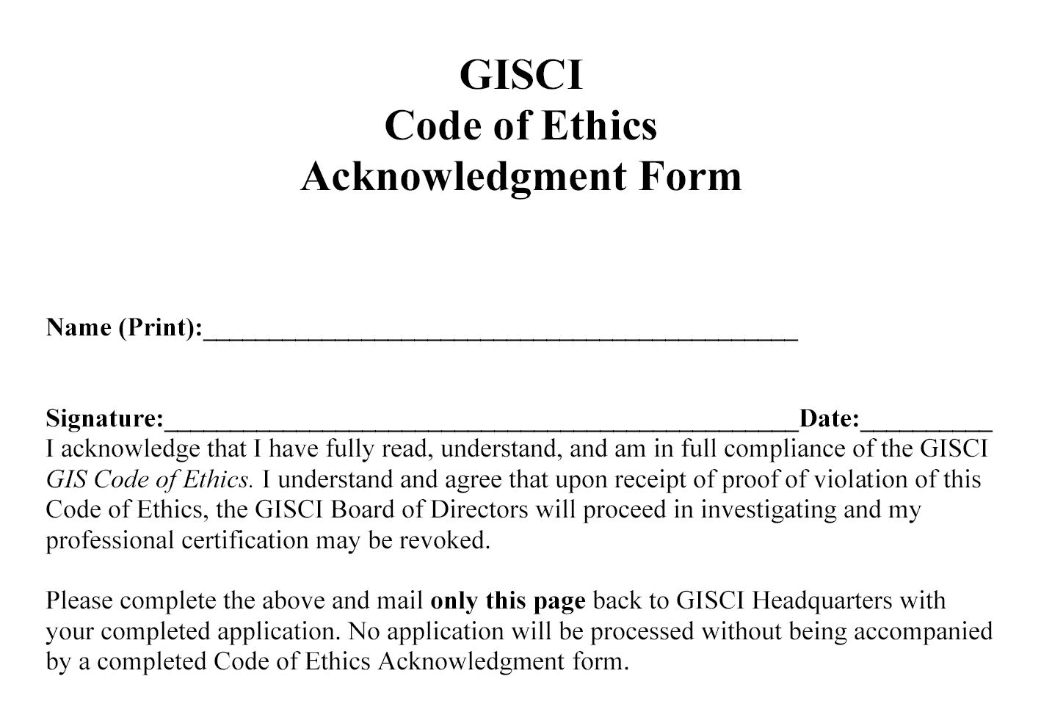

Slide 21
Optional Demographics Questionnaire
The application packet contains a questionnaire that will provide GISCI some background information on their certified members.
Not completing the questionnaire will in no way jeopardize the consideration of your application.

Slide 22
Arranging the Completed Application
NO STAPLES, PAPER CLIPS, or OTHER FASTENERS should be included in the portfolio.
All items should be grouped together loose and sent in a pocket folder.
Portfolios should not be bound, laminated, or enhanced aesthetically.
All portfolios are scanned electronically and inclusion of these items may substantially delay the processing of an application.

Slide 23
Arranging the Completed Application
NOTE: No completed applications or individual application materials, under any circumstances, will be returned to the submitter.

Slide 24
The Completed Application
Mailing Instructions The completed application should be placed in a file or pocket folder and sealed in an envelope.
Proper postage should be applied and the portfolio should be sent to GISCI headquarters at the following address:
GIS Certification Institute
701 Lee Street, Suite 680
Des Plaines, IL 60016
Upon receipt, a confirmation notice will be sent to the applicant.

Slide 25
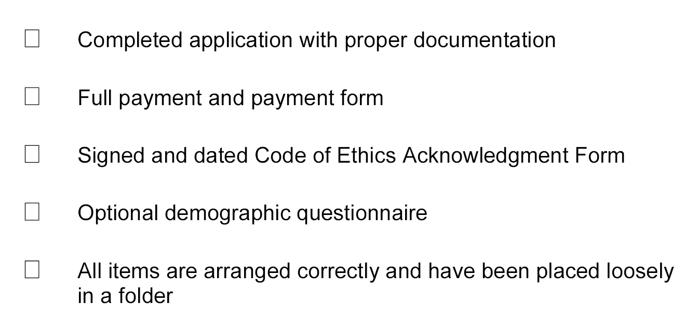
Application Checklist

Slide 26
You are now completed with the GISCI Certification Process
Thank you very much for your interest and support.

Slide 27
Any Questions?
Contact GISCI
www.gisci.org
Email: info@gisci.org
Phone 847-824-7768
Fax 847-824-6363

